Slide 1


<Name>
<Date>

Slide 2

Outline
Executive Summary
Introduction
Methodology
Results
Conclusion
Appendix

Slide 3
Executive Summary
Methodologies:
Encode categorical features using One Hot Encoder
Predict a landing’s success using basic machine learning algorithms: Logistic Regression, Support Vector Machines, K Nearest Neighbors and Multinominal Naïve Bayes
Result:
All models have an accuracy of 83.33% on test set
The major problem of all models are the number of false positives, 3.

Slide 4
Introduction
Space travel is becoming commercially available
Landing successful ➔ first stage reused ➔ travel’s cost considerably saved
Our problem: determining whether a landing is successful or not based on multiple factors:
Payload’s mass
Orbit type
Launch site
Number of flights
Having grid fins or not
Reused counting
Block number
Landing pad’s code

Slide 5

Section 1

Slide 6
Methodology
Executive Summary
Data collection methodology:
Describe how data was collected
Perform data wrangling
Describe how data was processed
Perform exploratory data analysis (EDA) using visualization and SQL
Perform interactive visual analytics using Folium and Plotly Dash
Perform predictive analysis using classification models
How to build, tune, evaluate classification models

Slide 7
Data Collection
Dataset used: SpaceX Launch Data
Data is collected by calling SpaceX’s API, i.e. making a GET request to https://api.spacexdata.com/v4/[endpoint]
[endpoint] is:
/launches/past: get comprehensive past launch data and is the need to get data from the below endpoints
/rockets/: get booster’s name
/launchpads/: get launch site’s name, latitude and longtitude of each launch
/payloads/: payload’s mass and orbit of each launch
/cores/: landing’s outcome, number of flights, block number, etc.

Slide 8
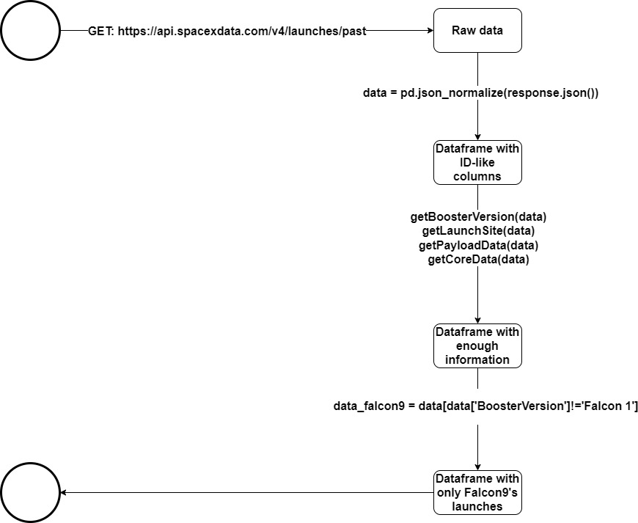
Data Collection – SpaceX API
Place your flowchart of SpaceX API calls here
GET request ➔Raw data ➔ Some converts ➔ Final dataframe
Reference this notebook

Slide 9
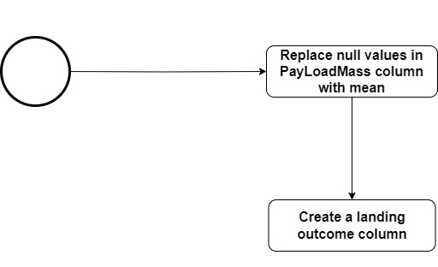
Data Wrangling
Calculating the number of null values in each column
Converting null value to the mean of that column
Reference this notebook

Slide 10
EDA with Data Visualization
Categorical plots: to see the relationship between FlightNumber, PayloadMass, LaunchSite and the launch outcome
Bar chart: to see the relationship between success rate and orbit type
Scatter plot: to see the relationship between FlightNumber, PayloadMass, Orbit and the launch outcome
Line plot: to see the success rate from 2010 to 2020
Reference this notebook

Slide 11
EDA with SQL
Using bullet point format, summarize the SQL queries you performed
Add the GitHub URL of your completed EDA with SQL notebook, as an external reference and peer-review purpose

Slide 12
Build an Interactive Map with Folium
Circle: highlight an area with specific coordinates, e.g. NASA Johnson Space Center
Marker: add text label to a Circle object or a PolyLine object
Circle group: add a circle polygon surrounding an area
Marker cluster: group markers with the same coordinates
PolyLine: draw a line between two destinations
Reference this notebook

Slide 13
Build a Dashboard with Plotly Dash
Dropdown list: offer various launch site options for users to select
Pie chart:
If “All Sites” is selected, represent the total number of successful landings in all launch sites
If a specific launch site is selected, represent the successful/failed landing ratio and the number of them
Slider: to choose a payload range to plot a scatter plot of PayloadMass vs the landing’s outcome
Scatter plot: to illustrate the relationship between PayloadMass and the landing’s outcome
Reference this Python script

Slide 14
Predictive Analysis (Classification)
For each model, set a value range for its hyperparameters ➔ find the set of hyperparameters that yield the best accuracy on training set
Grid Search Cross Validation is employed:
Set cv = 10, param_grid = {param1: [value1.1, value1.2],
param2: [value2.1, value2.2],
…}
For each hyperparameter, dataset is divided into 10 subsets. The training phase will take 10 times, each time one subset acts as the testing set
Calculate the average test score of 10 times
Reference this notebook

Slide 15
Results
Exploratory data analysis results
Interactive analytics demo in screenshots
Predictive analysis results

Slide 16

Section 2

Slide 17
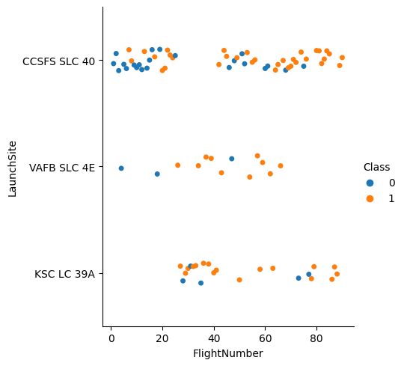
Flight Number vs. Launch Site
In the latter flights, the team responsible for a missile program has more experience and improve many aspects of the rocket
➔ success rate higher than that of the former ones

Slide 18
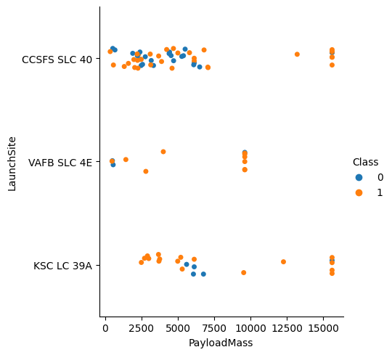
Payload vs. Launch Site
Higher payload ➔ extensive testing and scrutiny ➔ risks minimized ➔ higher success rate
VAFB SLC-4E is often employed for Earth observation satellites and other scientific missions, which tend to have payloads up to 10,000 kg

Slide 19
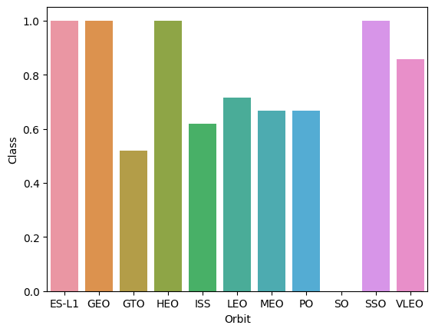
Success Rate vs. Orbit Type
SSO:

Slide 20
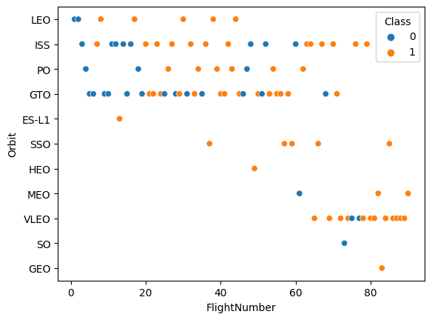
Flight Number vs. Orbit Type
First launches tend to expose to failure ➔ more experience, more improvement on the rocket’s design and payload ➔ following launches have more chance to succeed
Launches with flight number > 80 always succeed
SSO, HEO and ES-L1 orbits have 100% successful launch rate, but with very little total number of launches
VLEO is only employed for flight with order > 60

Slide 21
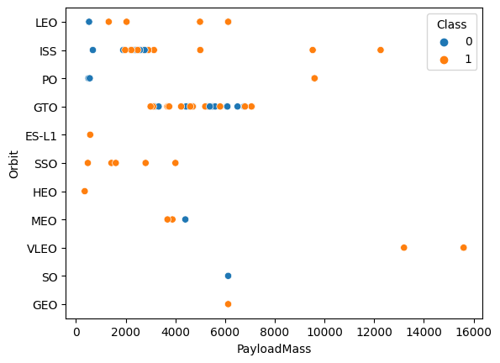
Payload vs. Orbit Type
With heavy payloads the successful landing rate are more for PO, LEO and ISS orbits

Slide 22
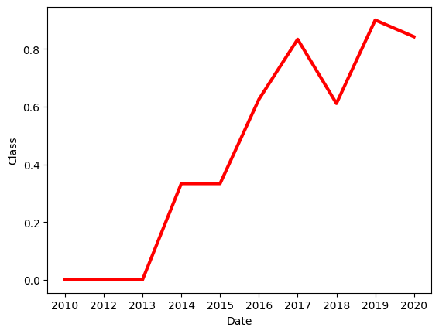
Launch Success Yearly Trend
SpaceX’s rockets have been strengthened through years ➔ increasingly high success rate
Notable decreases occur between 2017 and 2018, 2019 and 2020

Slide 23
All Launch Site Names
Find the names of the unique launch site:
pd.read_sql_query(“select distinct Launch_Site from SPACEXTBL”, con)
read_sql_query() is a Pandas’ function to execute SQL query
con is the cursor pointing to the table
Unique launch site ➔ select distinct Launch_Site from …

Slide 24
Launch Site Names Begin with 'CCA'
Find 5 records where launch sites begin with `CCA`:
pd.read_sql_query("select * from SPACEXTBL where Launch_Site like 'CCA%' limit 5", con)
Launch sites have a pattern of “CCA…” ➔ Launch_Site like ‘CCA%’
where: keyword, indicating a condition
5 records, not all rows ➔ limit 5

Slide 25
Total Payload Mass
Calculate the total payload carried by boosters from NASA
Present your query result with a short explanation here

Slide 26
Average Payload Mass by F9 v1.1
Calculate the average payload mass carried by booster version F9 v1.1
Present your query result with a short explanation here

Slide 27
First Successful Ground Landing Date
Find the dates of the first successful landing outcome on ground pad
Present your query result with a short explanation here

Slide 28
Successful Drone Ship Landing with Payload between 4000 and 6000
List the names of boosters which have successfully landed on drone ship and had payload mass greater than 4000 but less than 6000
Present your query result with a short explanation here

Slide 29
Total Number of Successful and Failure Mission Outcomes
Calculate the total number of successful and failure mission outcomes
Present your query result with a short explanation here

Slide 30
Boosters Carried Maximum Payload
List the names of the booster which have carried the maximum payload mass
Present your query result with a short explanation here

Slide 31
2015 Launch Records
List the failed landing_outcomes in drone ship, their booster versions, and launch site names for in year 2015
Present your query result with a short explanation here

Slide 32
Rank Landing Outcomes Between 2010-06-04 and 2017-03-20
Rank the count of landing outcomes (such as Failure (drone ship) or Success (ground pad)) between the date 2010-06-04 and 2017-03-20, in descending order
Present your query result with a short explanation here

Slide 33

Section 3

Slide 34
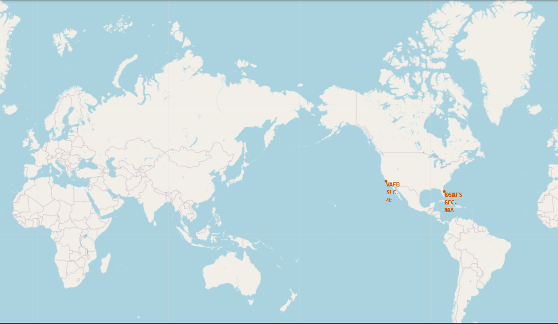
Location of launch sites
All launch sites are located in close proximity to the nearest coast
Launch sites in Florida are proximal to each other. This can be explained by these points:
Near the equator ➔ bonus velocity during a rocket’s launch ➔ improve capability to reach certain orbits
Efficient transportation of equipment and personnel between different sites ➔ reduces logistical challenges.

Slide 35
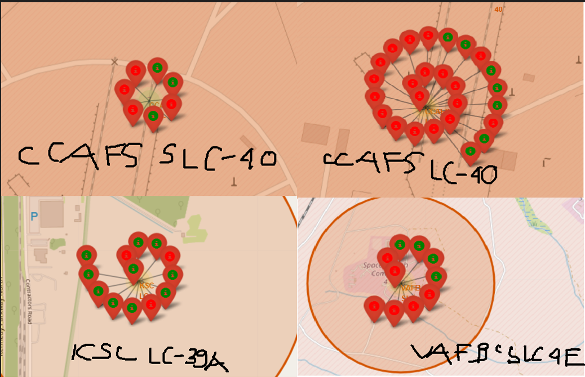
Launch outcomes of each site
KSC LC-39A has the highest success rate
CCAFS LC-40 has the highest number of launches but the lowest success rate

Slide 36
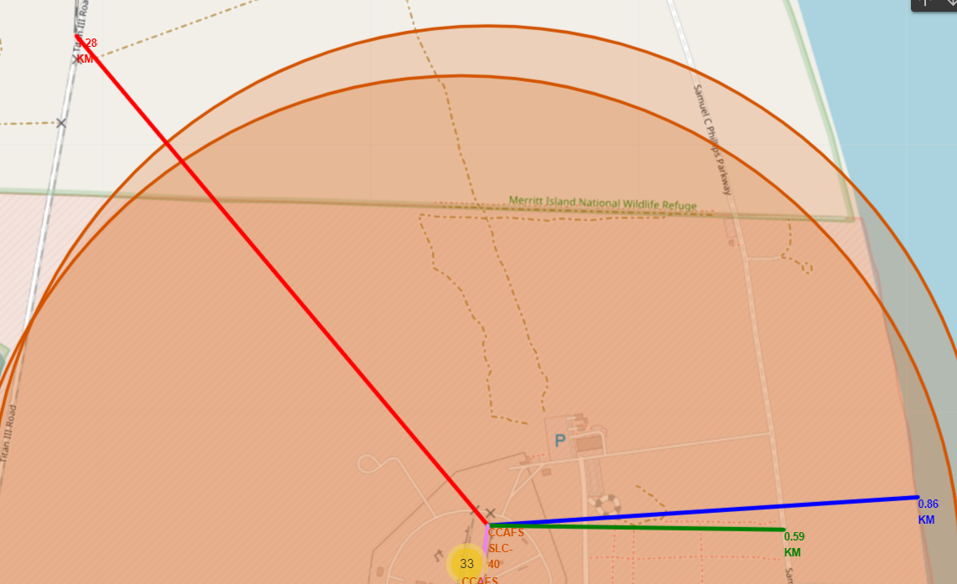
CCAFS SLC-40’s distance to certain proximities
Samuel C Phillips Parkway highway provides crucial transportation links for the movement of heavy and oversized equipment and components required for space missions ➔ in close distance (590 meters)
Coast provides unrestricted airspace and launch safety ➔ in close distance (860 meters)
While railroad may supplement rocket components and other facilities, for safety it should be relatively far from the launch site ➔ 28 kilometers from Titan III Railroad

Slide 37

Section 4

Slide 38
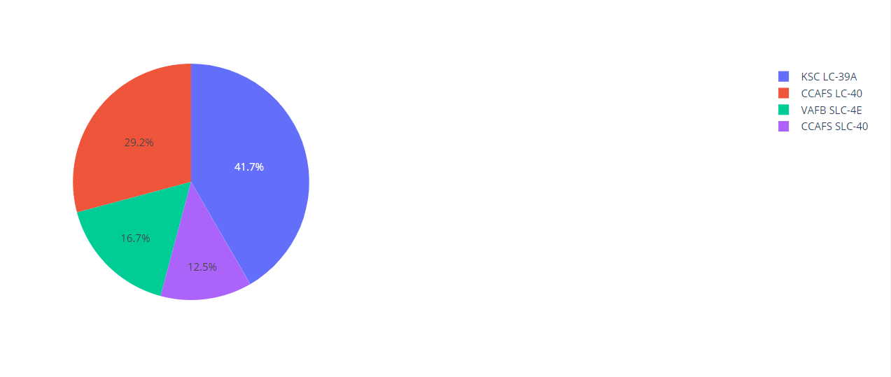
Launch success count share between sites
Florida accounts for 83.4% number of successes, while California makes up 16.7%
% of flight success in KSC LC-39A = % in CCAFS LC-40 + % in CCAFS SLC-40
% of flight success in CCAFS LC-40 = % in VAFB SLC-4E + % in CCAFS SLC-40

Slide 39
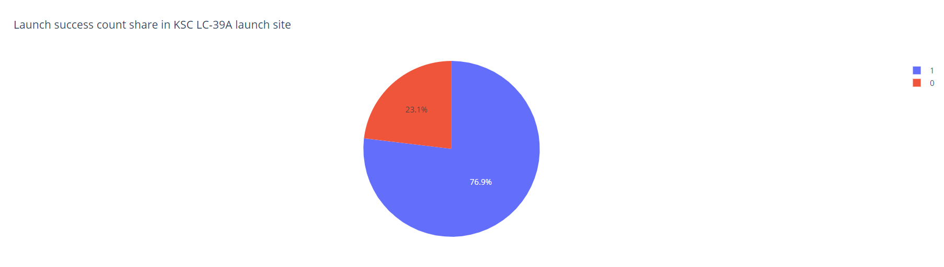
Launch site with highest success rate
KSC LC-39 A has highest launch success rate, with 76.9% of landings are successful

Slide 40
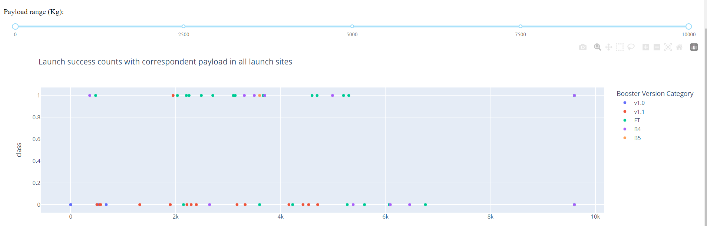
Booster with the highest success rate
Set the payload range to be 0 to 10000.
FT has the highest success rate, with 68.42% of flights landed successfully

Slide 41
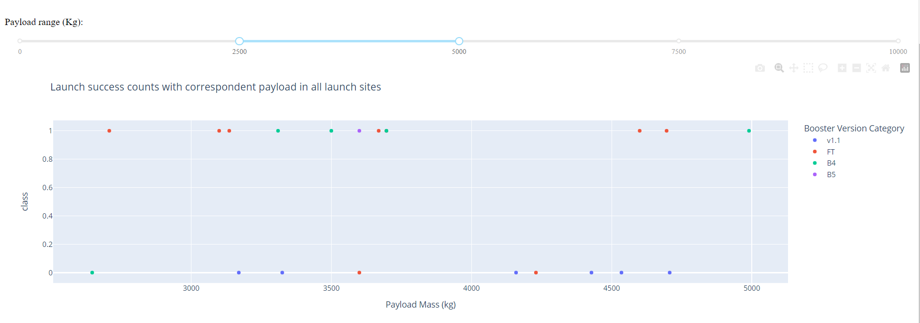
Booster with the highest success rate
Payload range from 2500 to 5000 has the highest success rate, with 55% of flights landed successfully

Slide 42

Section 5

Slide 43
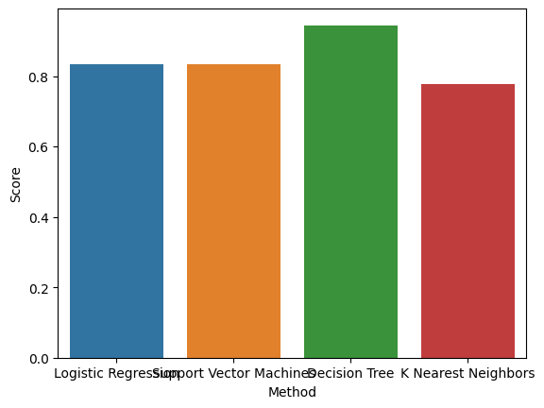
Classification Accuracy
Decision Tree achieves the highest accuracy on test set, with 94.44% of samples are accurately classified

Slide 44

Decision Tree’s confusion matrix
Only 1 sample is falsely labelled (ground truth: did not land, predicted: land)
All samples belonging to land class are truly classified

Slide 45
Conclusions
A rocket’s landing outcome can be predicted using machine learning and visualization techniques instead of doing math and physics
Optimize time and resource allocation for launching spaceship
The correlation between factors is not well-researched enough
➔ Future development: discover more patterns in data and perform more preprocessing techniques to remove unwanted information from the dataset that can badly affect the machine learning model’s performance

Slide 46
Appendix
Include any relevant assets like Python code snippets, SQL queries, charts, Notebook outputs, or data sets that you may have created during this project

Slide 47


